Slide 1

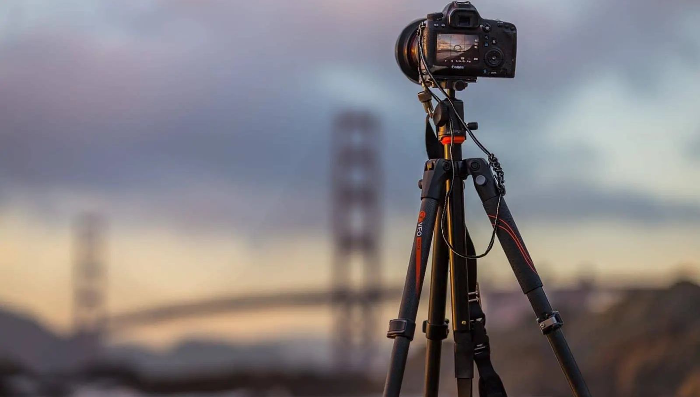

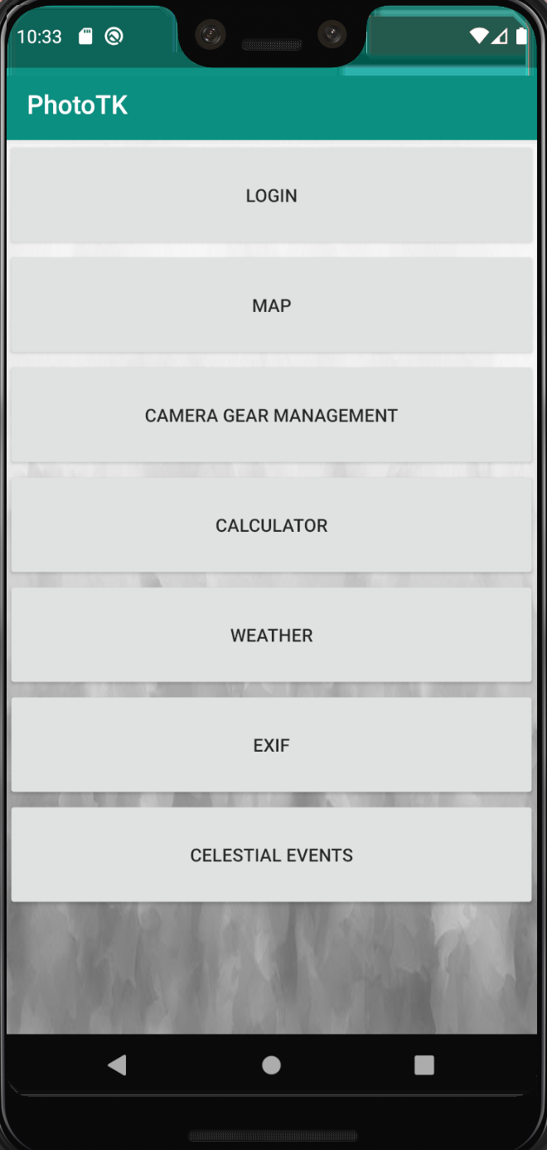
PhotoTK
Sprint 1 presentation
Brett Heithold
Brian Lee
Xietong Wei
Minrui Huang

Slide 2
Overview
All-in-one toolkit for photographers
Calculator (Camera Settings)
Gear management
Weather
Track geolocation
Edit EXIF information
Lookup celestial events

Slide 3
Login UI

Slide 4
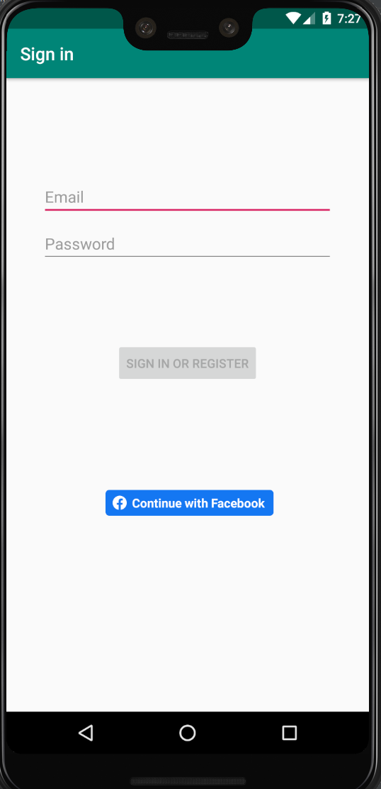
Firebase Authentication
Login page
The purpose for people to login is to save the settings, so users wouldn’t need to adjust everything again later on.
(The functions have not been implemented yet.)

Slide 5
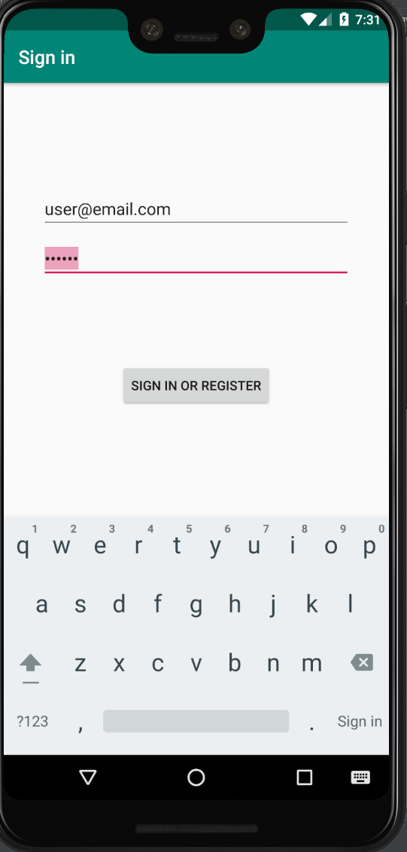
a
Email registration
Register with an email address and a password that has length >= 6.
It doesn’t do anything yet but jump back to home page since database is not completely setup.

Slide 6
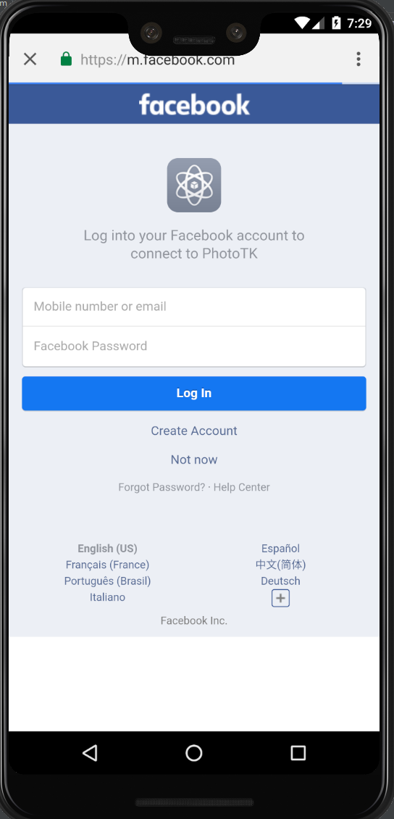
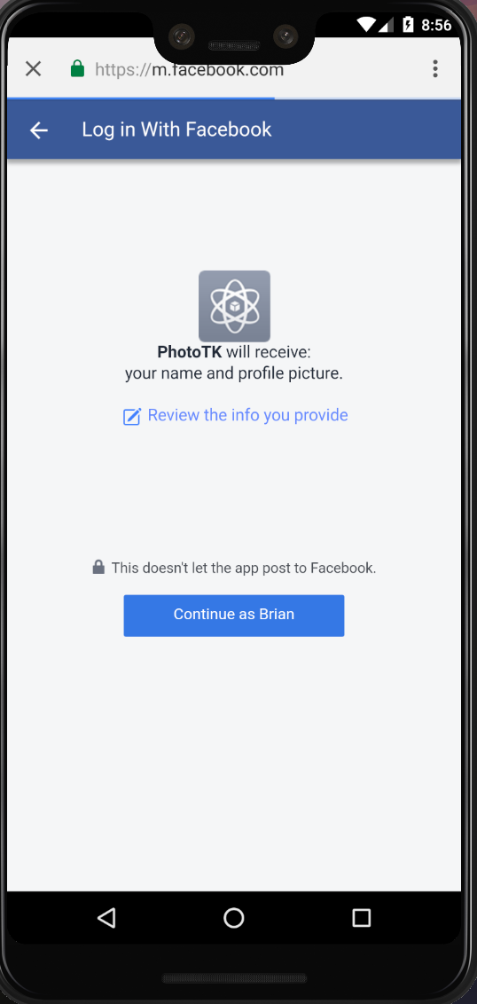
Facebook SDK
1
Another way is that users can authenticate with Firebase using their Facebook accounts.
We wouldn’t have much access. Users don’t have to worry about getting their personal information stolen.

Slide 7
Map & Geolocation

Slide 8
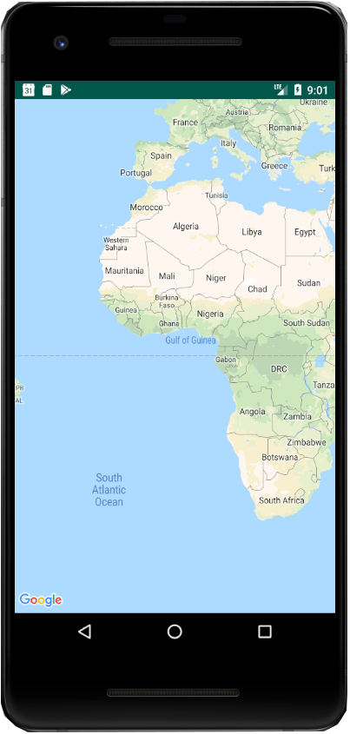
Map
Not Difficult
Google Maps API
Created Google Maps Activity
Linked with API key

Slide 9
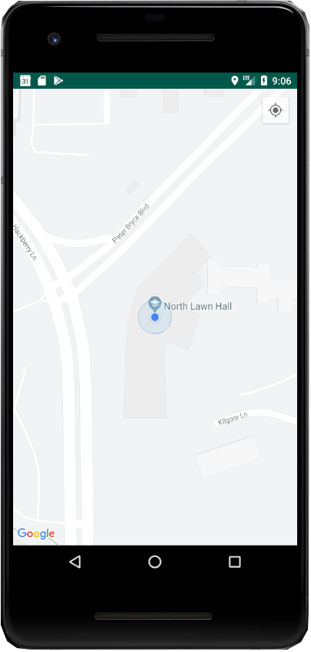
Geolocation
Considerably more difficult
Google Location Services
FusedLocationProviderClient

Slide 10
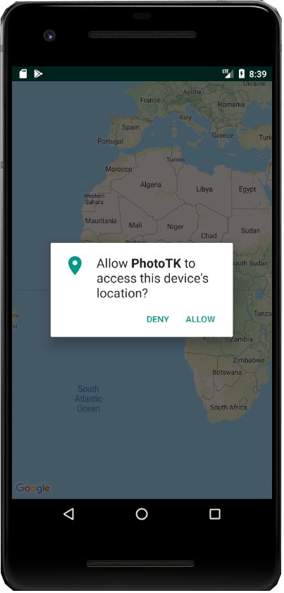
Geolocation
Asking Permission
Only one permission needed
Access Fine Location

Slide 11
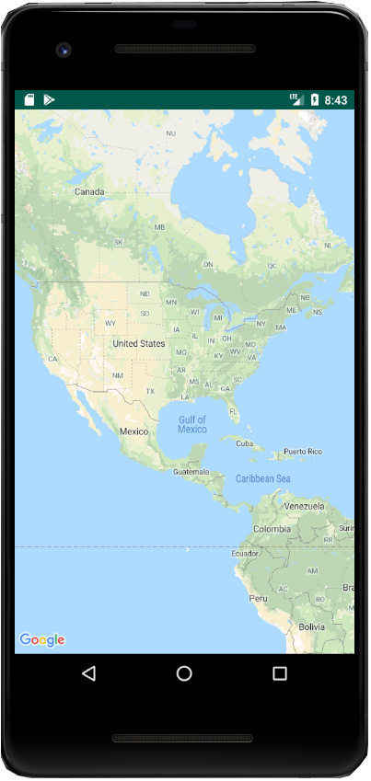
Geolocation
Permission Denied
Geolocation will not be available for other features

Slide 12
Celestial Events

Slide 13
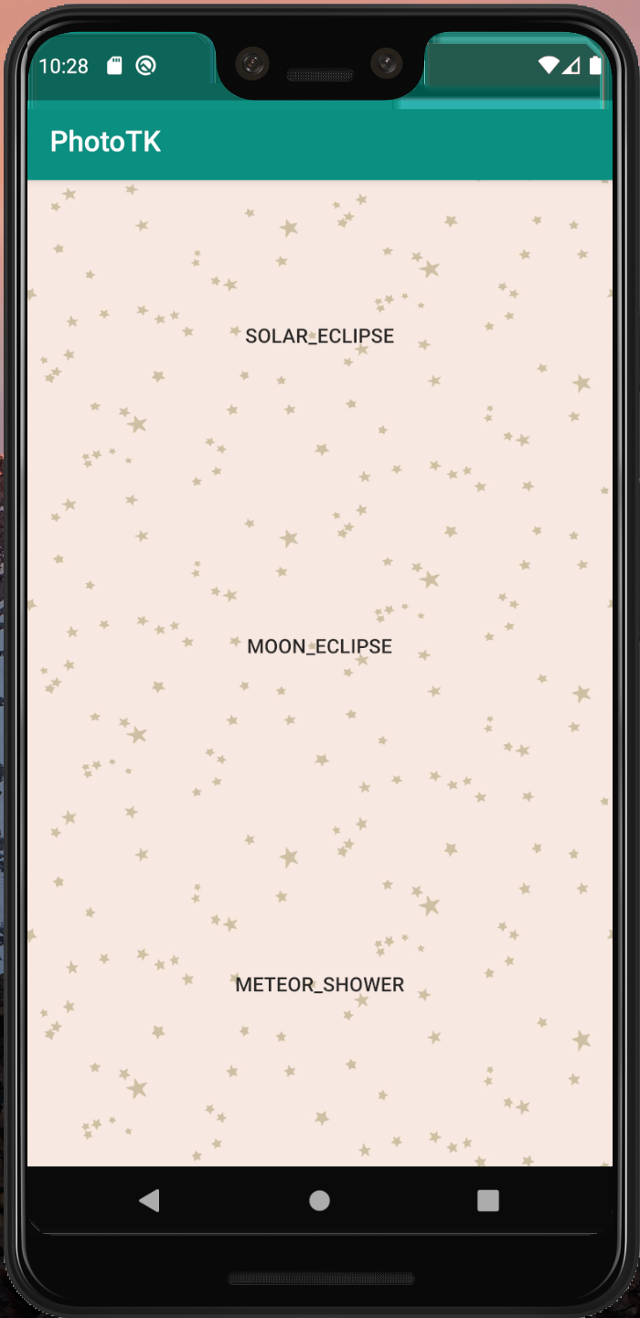
Celestial Event Page
This function can help users to get detailed information of future celestial events. It is a useful tool to advance the camera setting. Now, we have three celestial event information, which are solar eclipse, moon eclipse and meteor shower events.

Slide 14
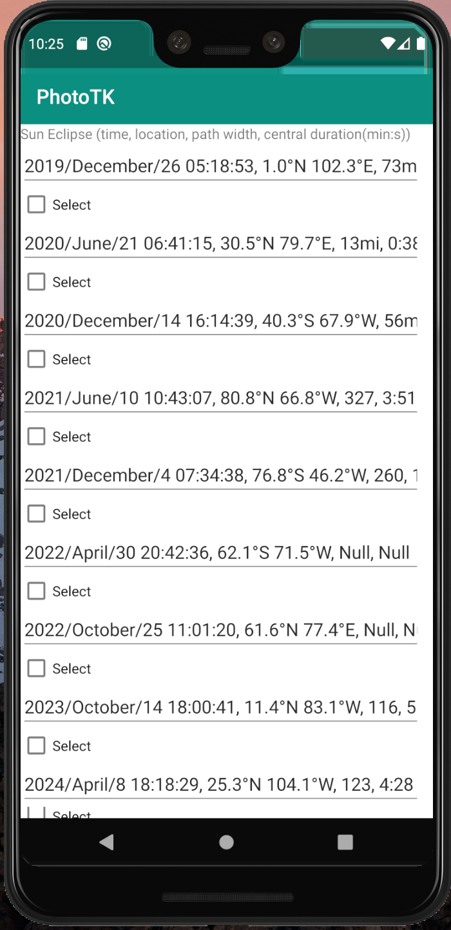
This page is about sun eclipse information. And in this page users can check the future sun eclipse information including time, location, path width and central duration. Below every data has a “Select” checkbox.

Slide 15
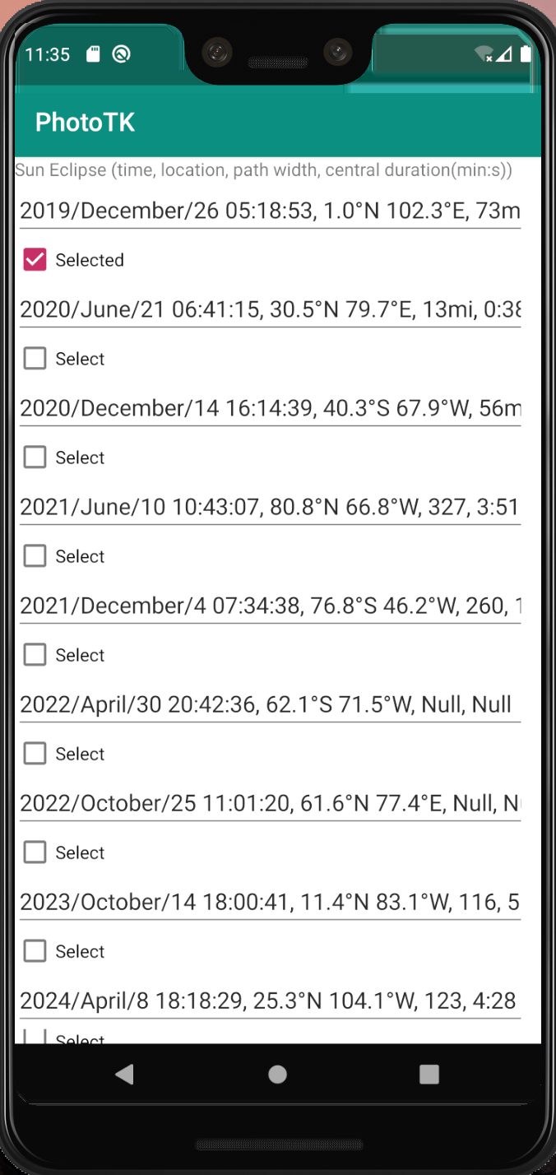
The select button status can be saved. So users can find their favorite events when they log in the application again. It is convenience.

Slide 16
Celestial Event Function
I will collect more celestial data in the future and add more operations on data.

Slide 17
Layout

Slide 18

I have finished a basic layout of the application. And in the future I will design a better user interface and layout.

Slide 19
EXIF info

Slide 20
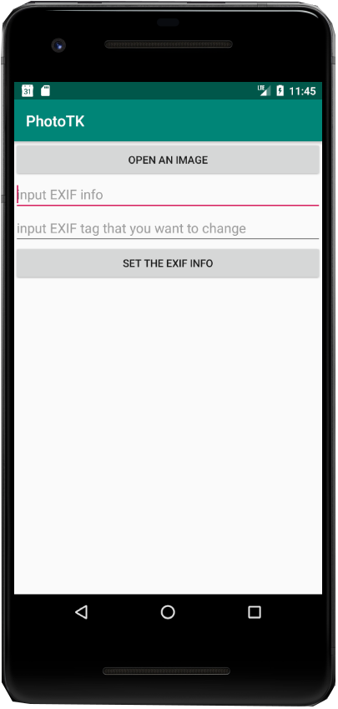
Exif Information
Read
User can open the photo and read the exif information and the photo

Slide 21
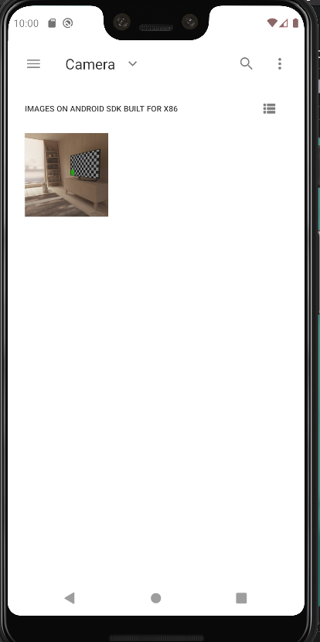
Exif Information
Read
User can open the photo and read the exif information and the photo

Slide 22
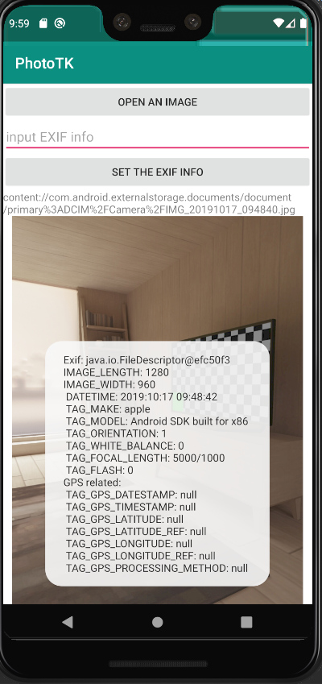
Exif Information
Read
User can open the photo and read the exif information and the photo

Slide 23
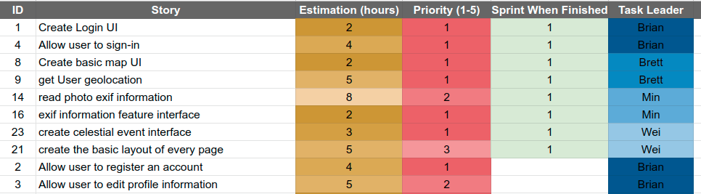
Backlog

Slide 24
Reflection - Challenges
Not familiar with Android Studio and Java
Very slow and problematic Android emulator.
Piecing everyone’s work together on Github.
Photo are read only on any phone. How to change the read only file to read and write is a challenges
Location Services

Slide 25
Demo

